Slide 1
TEACHER’S PERSONAL INFORMATION
Name: Nguyen Thanh Loan
Facebook: Loan Nguyễn Thanh
Mobile number: 0942 255 937
Email: loannguyenthanh1978@gmail.com
Facebook lớp: DH19QS-010112283701-TA1A

Slide 2
ONLINE ASSIGNMENTS
https://www.helbling-ezone.com
Course: DH19QS-010112283701
Course ID: GDW5-2CT9

Slide 3
UNIT 2
FAMILY AND HOME
LESSON 1
We have a fun family!

Slide 4
CONTENTS
Vocabulary: family members, rooms and furniture
Grammar: “have” in affirmative, negative and questions; possessive’s, “there is”, “there are” in affirmative, negative and questions.
Function: talking about your family; talking about furniture in your house.

Slide 5
Lesson 1
We have a fun family

Slide 6
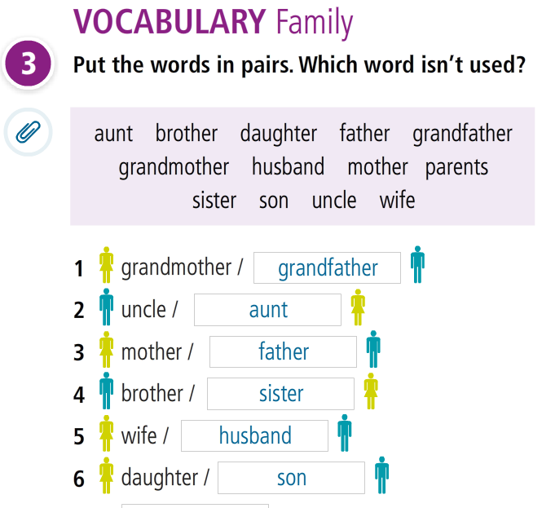

Slide 7
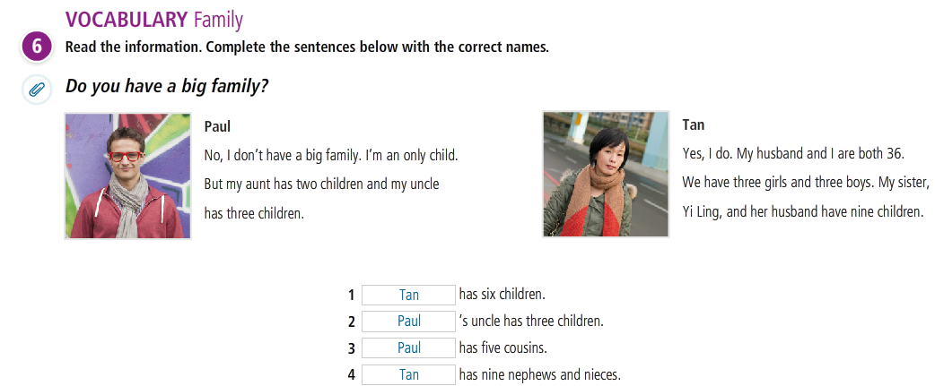

Slide 8

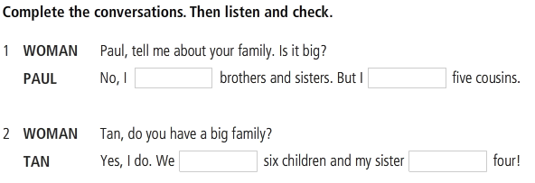
LISTENING

Slide 9
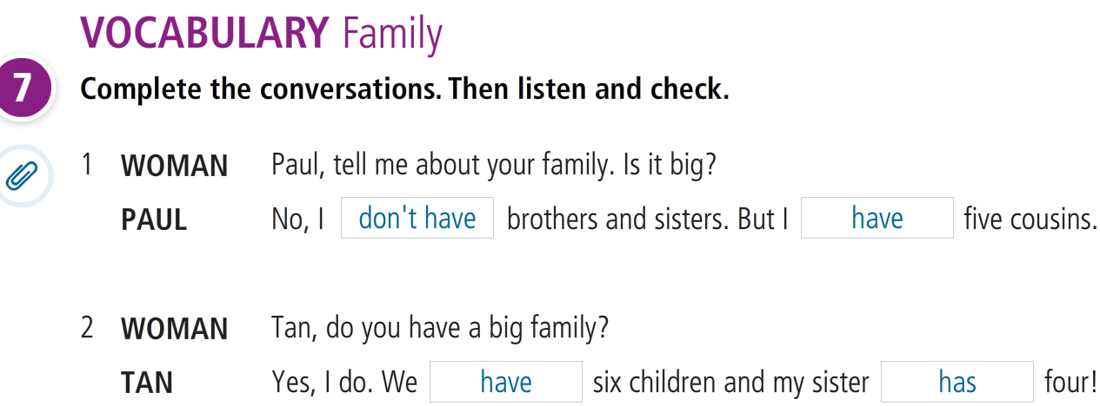

Slide 10
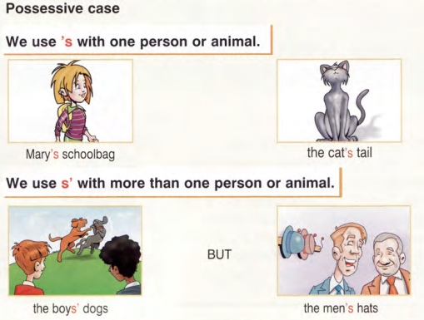
GRAMMAR
Possessive case

Slide 11
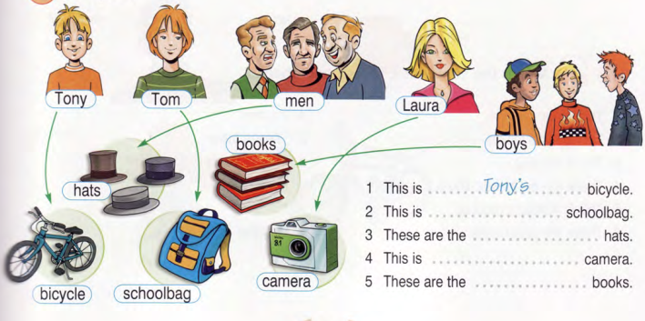
A child – 3 children
A man – 4 men
A woman – 5 women

Slide 12
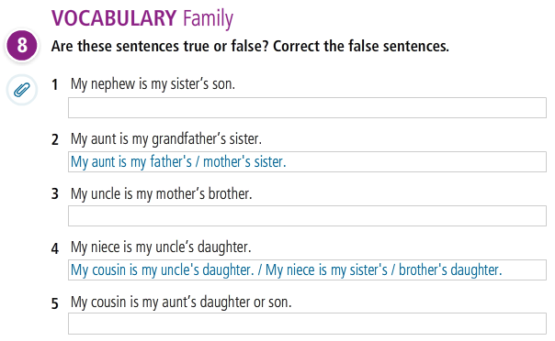

Slide 13
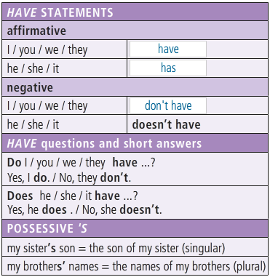
GRAMMAR 1 & 2
I

Slide 14
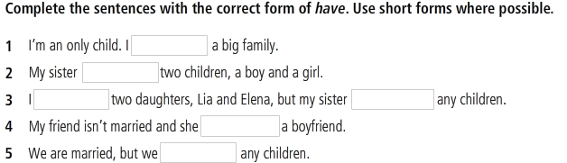
GRAMMAR PRACTICE

Slide 15
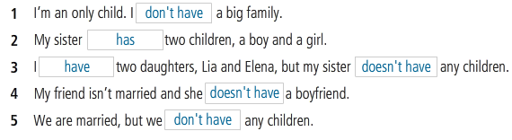
GRAMMAR PRACTICE

Slide 16
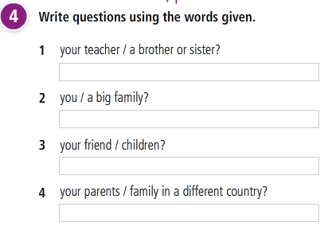
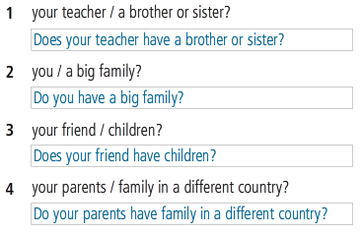
GRAMMAR PRACTICE

Slide 17
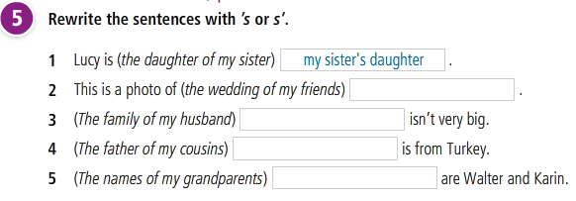
GRAMMAR PRACTICE

Slide 18
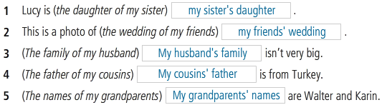
GRAMMAR PRACTICE

Slide 19
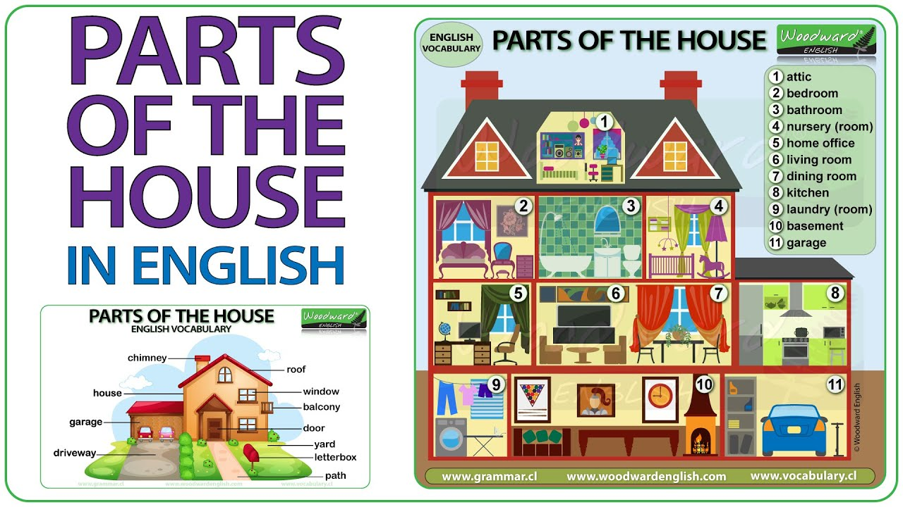
Lesson 2
ROOMS and FURNITURE
IN YOUR HOUSE
https://www.youtube.com/watch?v=m27Cck_LGHc

Slide 20
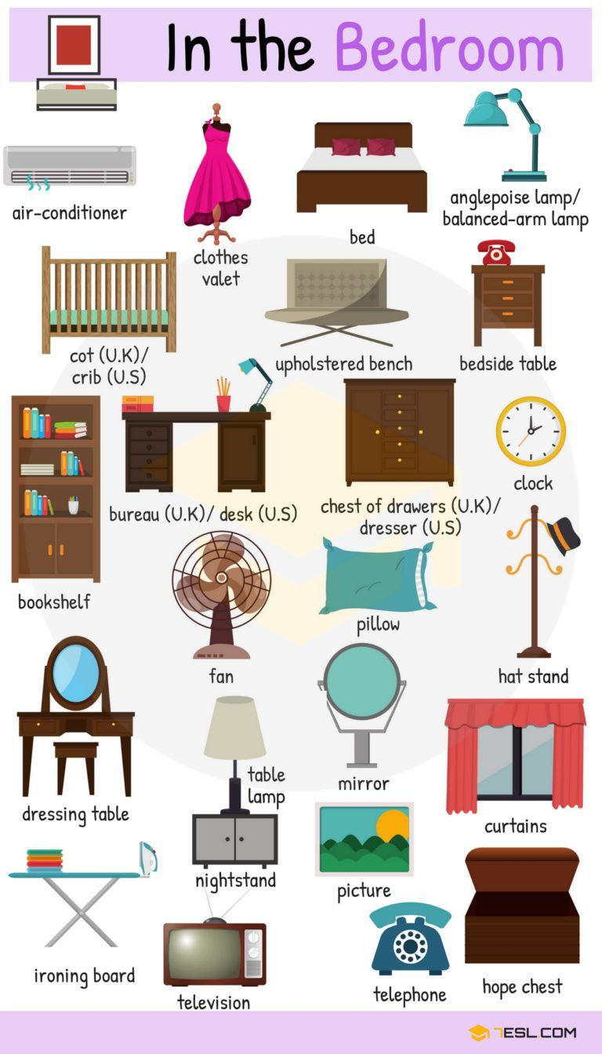
Furniture in the bedroom

Slide 21
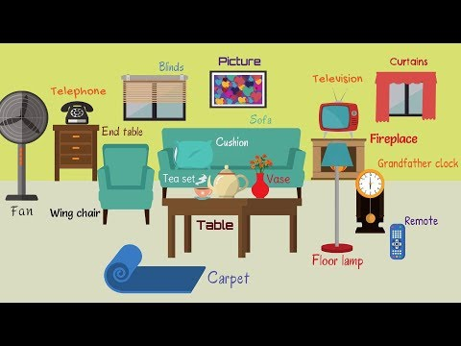
Furniture in the living room

Slide 22
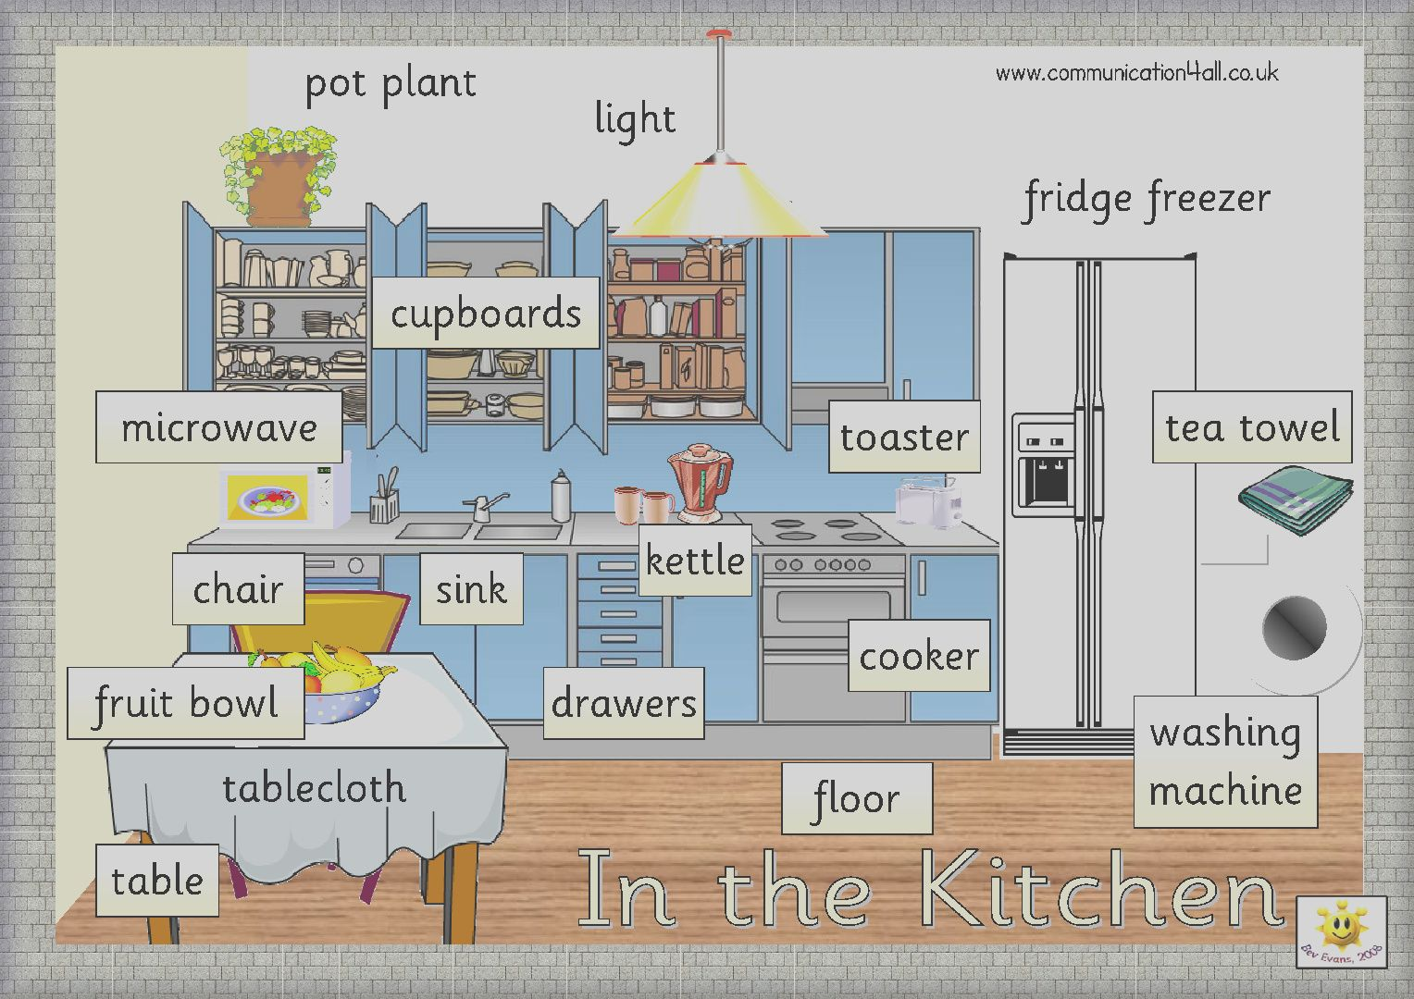
Furniture in the kitchen

Slide 23
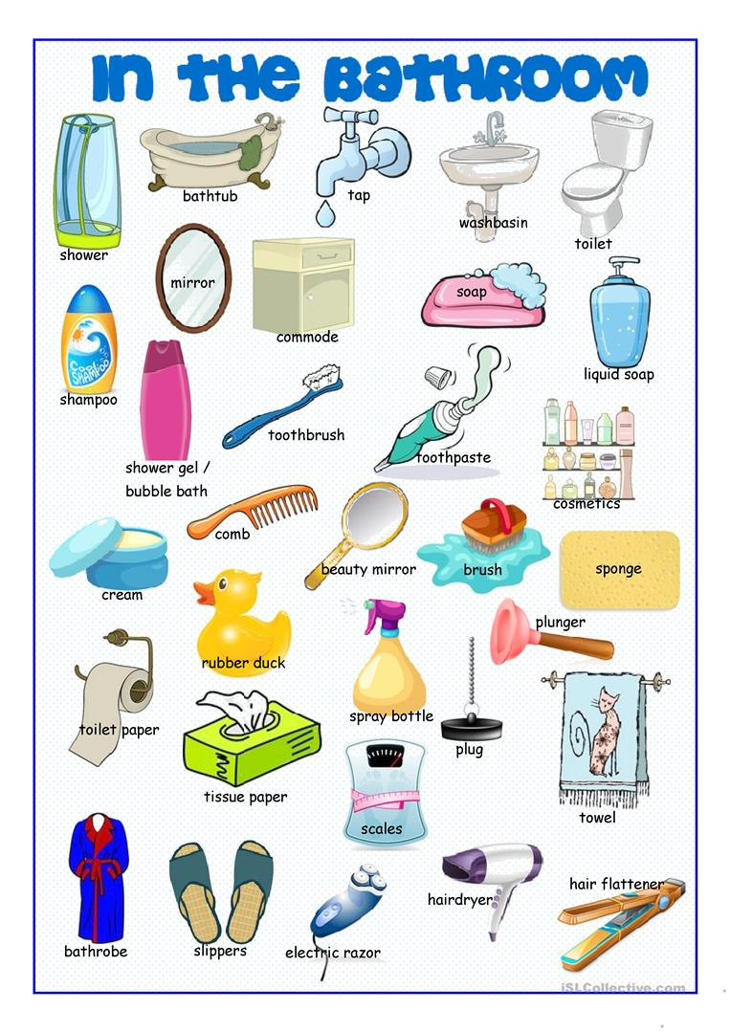

Slide 24
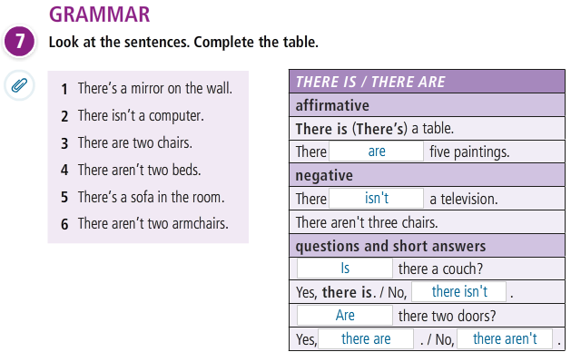
GRAMMAR: THERE IS/THERE ARE

Slide 25
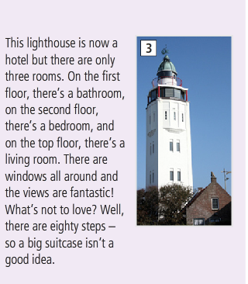
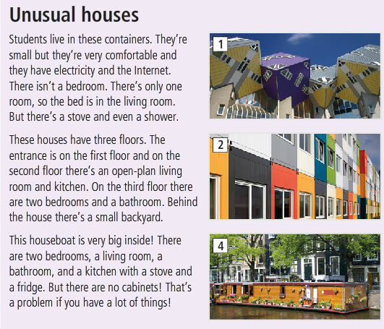
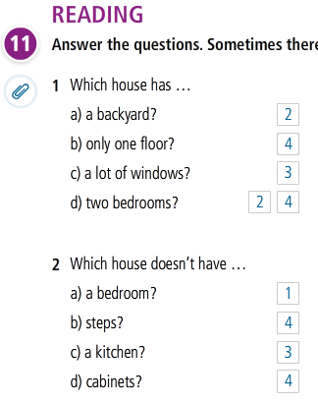

Slide 26
WRITING
Write an article about your home. Use photos or drawings to help you.
I have a small apartment in………
There’s ……………………………....
There are …………………………….

Slide 27
The end!

